Slide 1
CRYPTOCURRENCIES: BITCOIN
Daniel Barragues

Slide 2
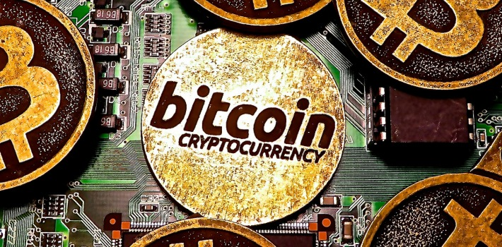
What is Bitcoin?

Slide 3
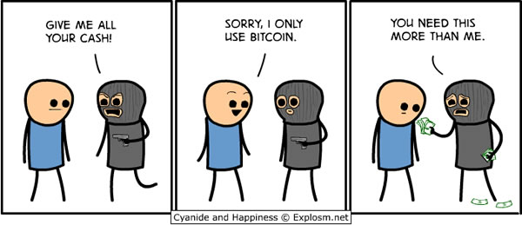
A little bit of its story
Notes:
-First decentralized digital currency.
-Satoshi Nakamoto.
-First transaction: 10,000 BTC for a papa johns pizza.

Slide 4
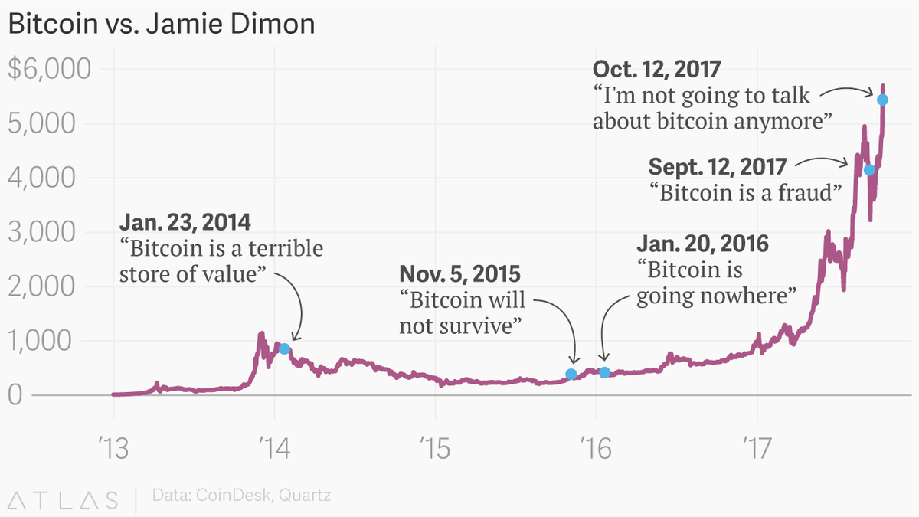
News and Bitcoin
Notes:
-Jamie Dimon
-News report about bitcoin only when it falls down dramatically or when it goes up like a rocket

Slide 5
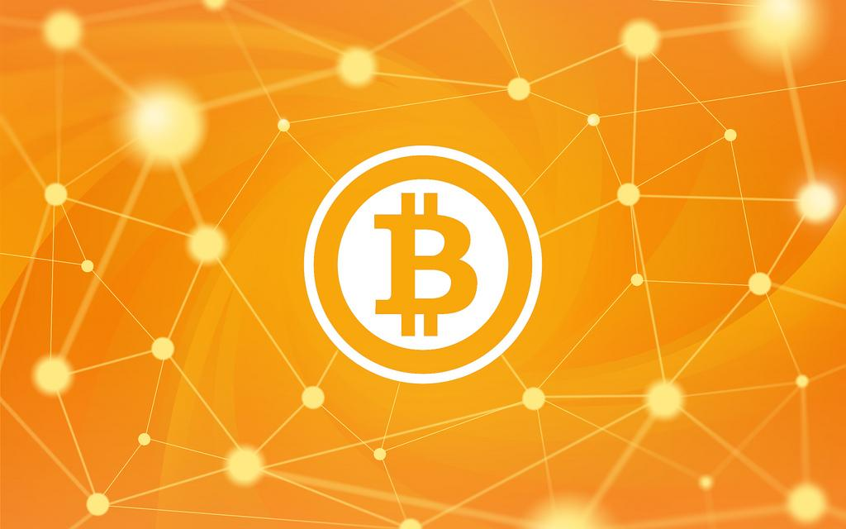
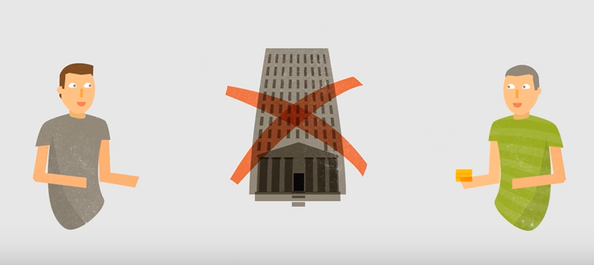
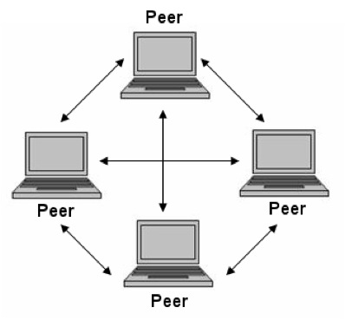
BUT, HOW DOES IT WORK?
Notes:
-Decentralized, no governments involved
-Peer to peer (P2P)
-Much lower fees, use it everywhere and accounts cant be frozen

Slide 6
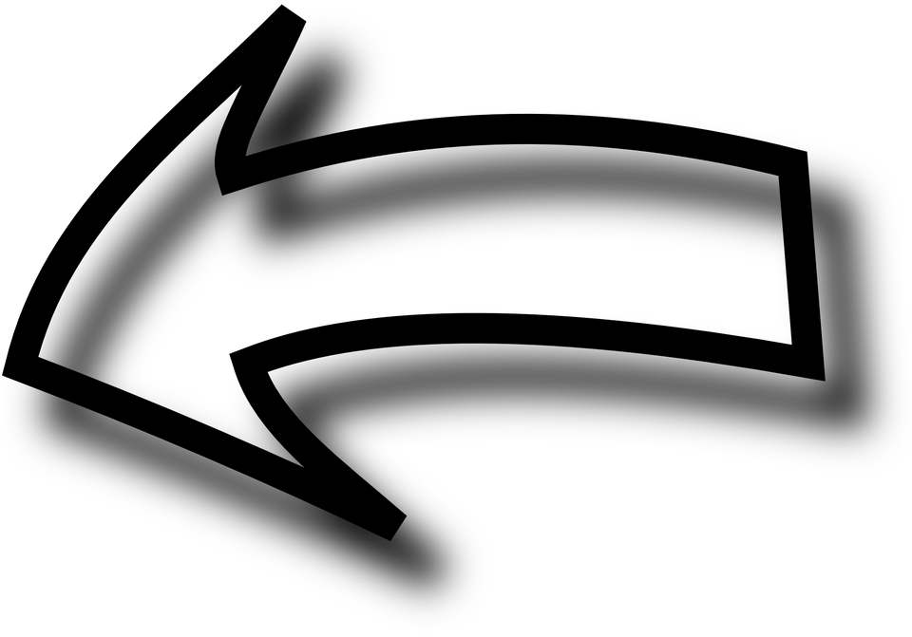
BUT, BUT, HOW DOES THINGS WORK?
Notes:
-Before I said that it worked via a P2P network, but how does that network work?
-First we have to understand what the blockchain is
-Board sample of sending bitcoin vs traditional banking
-Transparent public lecture of the transactions

Slide 7
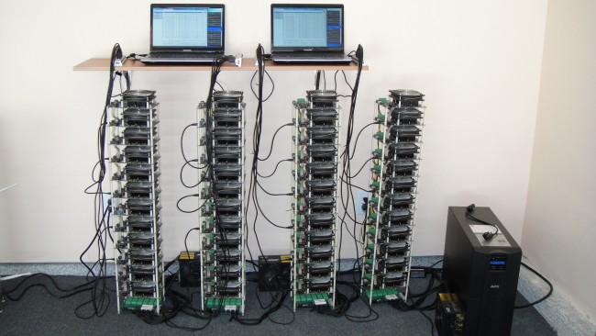
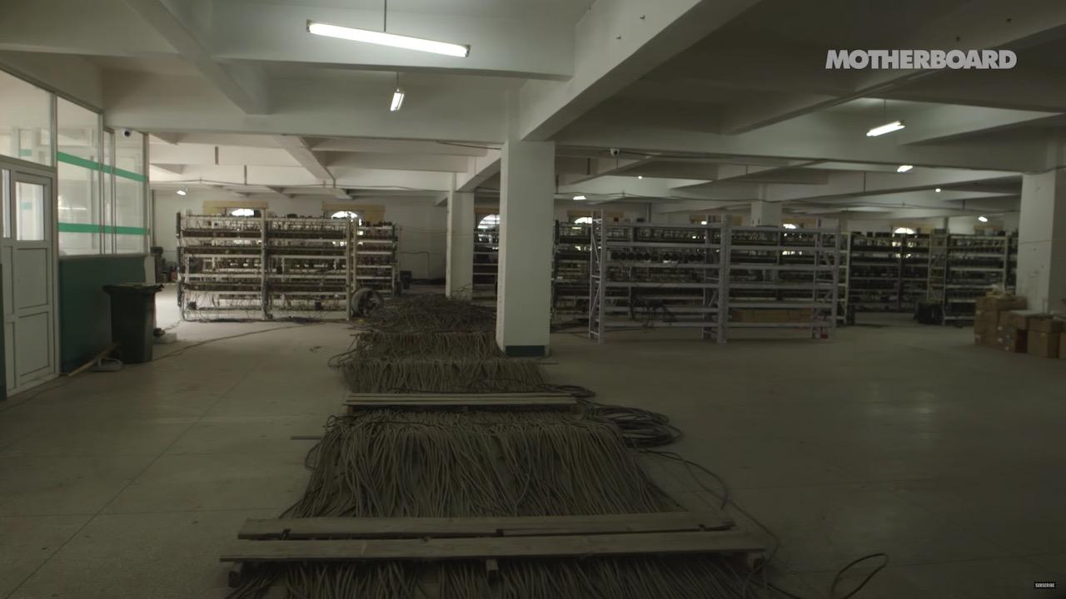
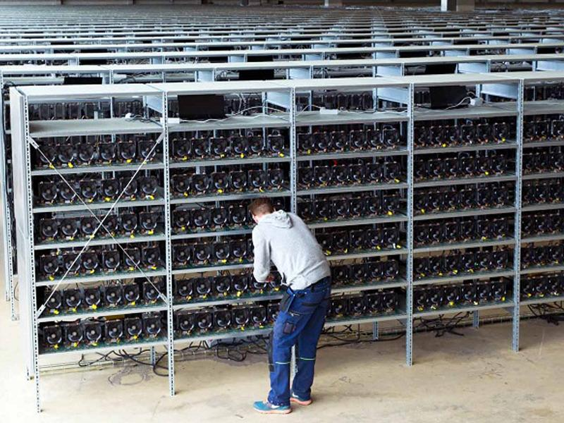
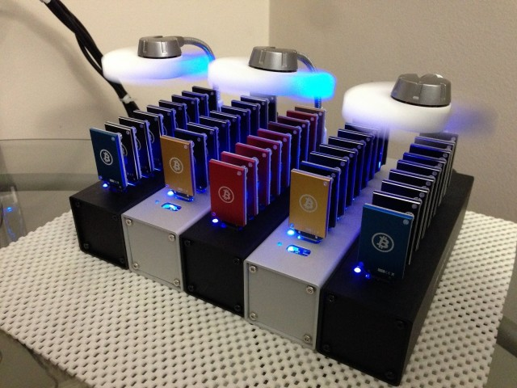
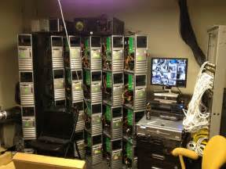
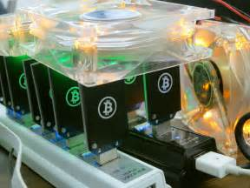
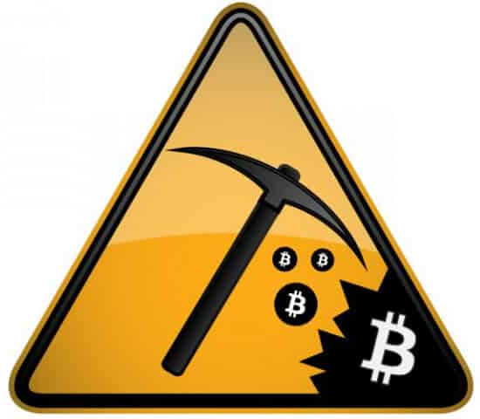
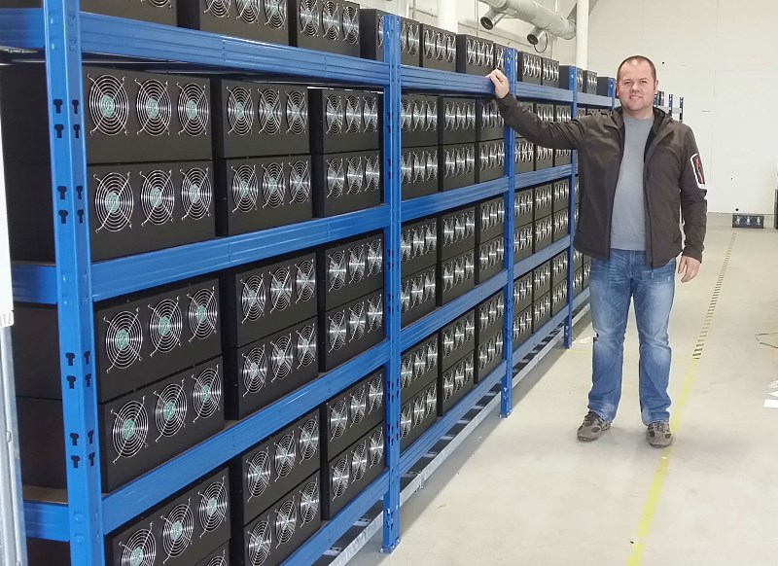
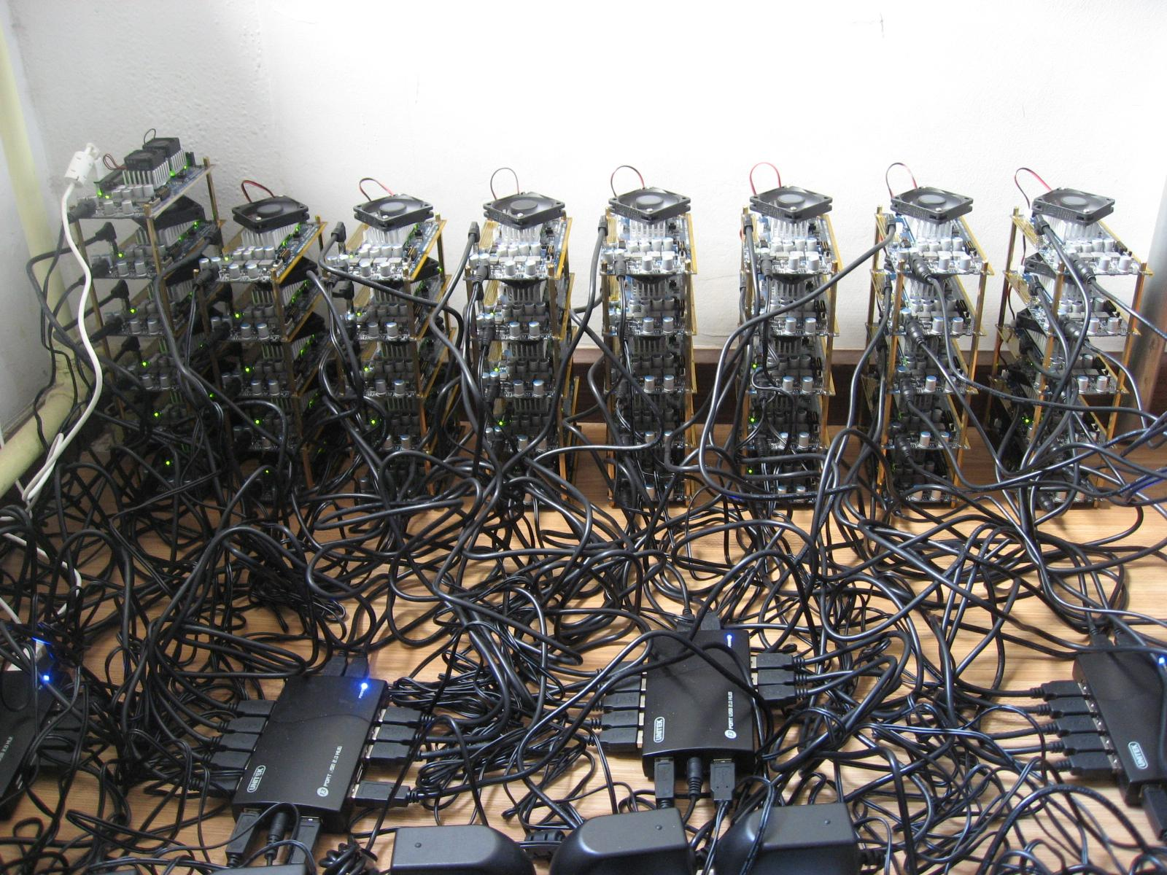
MINERS, THE COOL GUYS
Notes:
-Everyone wants to mine
-They verify transactions
-Because the difficulty of the block increases, you need more power each time to remain profitable

Slide 8
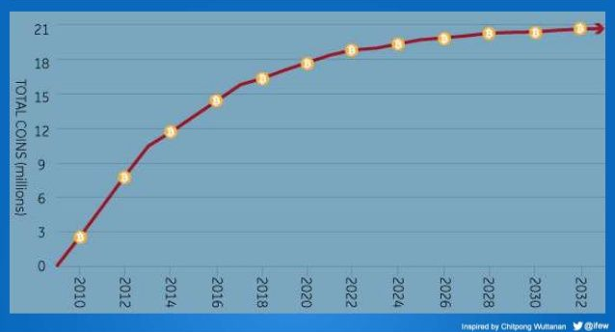
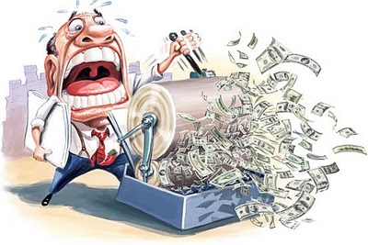
IF IT ISN’T CENTRALIZED, WHO REGULATES IT?
Notes:
-Goverments and banks print money whenever they want, so value goes up and down
-There only can be 21 million BTC, this means that it regulates itself
-Value will go up and down depending on the users, not on a decision of high ranked people
-There cant be inflation, because holding the bitcoin increases value too

Slide 9
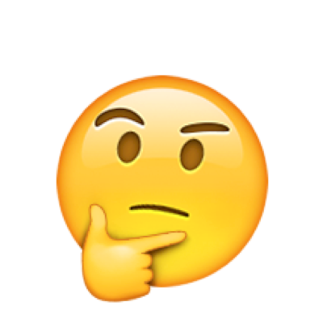
Any questions?

